Slide 1
Introducing the ecosystem of Maharaja Ranjit Singh College of Professional Sciences, Indore 2019-2020

Slide 2
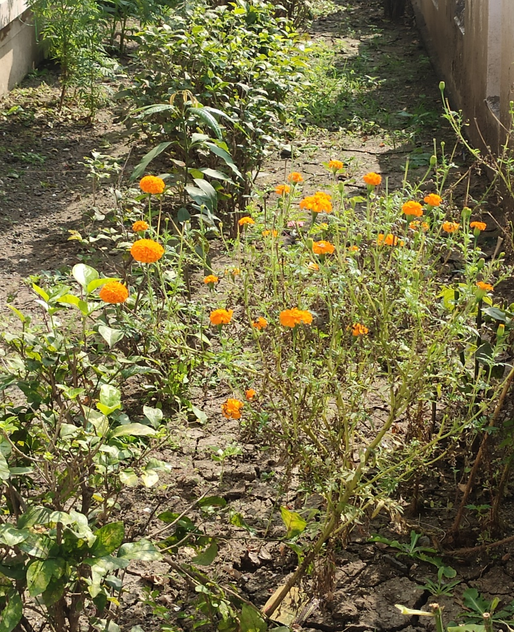
Marigold
Kingdom:Plantae
Clade:Tracheophytes
Clade:Angiosperms
Clade:Eudicots
Clade:Asterids
Order:Asterales
Family:Asteraceae
Subfamily:Asteroideae
Supertribe:Helianthodae
Tribe:Tageteae
Genus:Tagetes

Slide 3
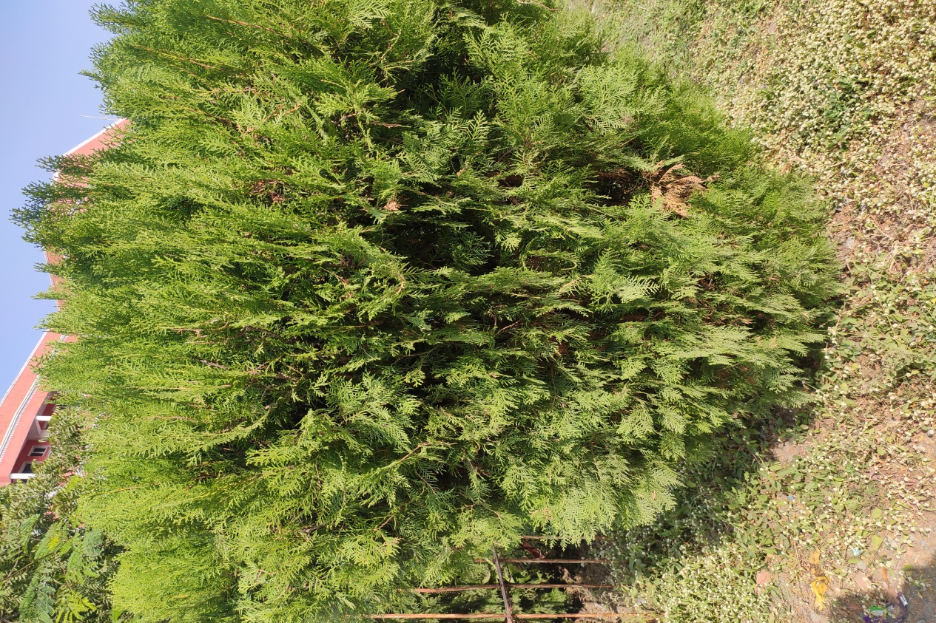
Oriental Arbor-Vitae
Kingdom:Plantae
Clade:Tracheophytes
Division:Pinophyta
Class:Pinopsida
Order:Pinales
Family:Cupressaceae
Subfamily:Cupressoideae
Genus:Platycladus SpachSpecies:P. orientalis

Slide 4
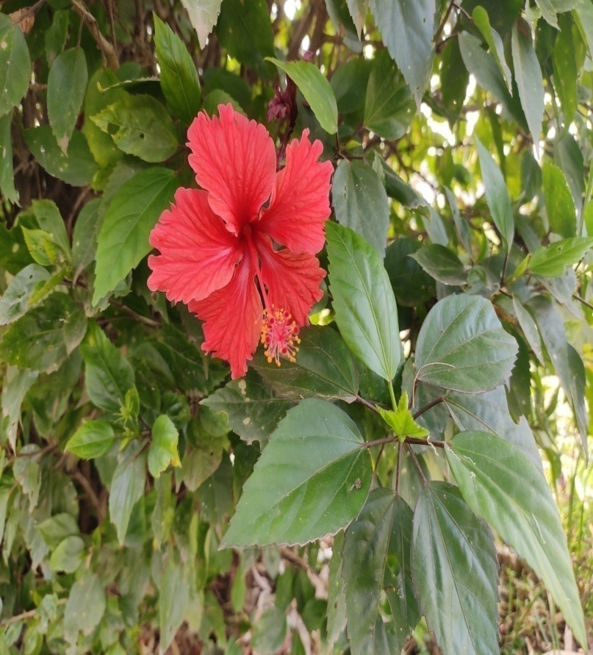
HIbisceae
Kingdom:Plantae
Clade:Tracheophytes
Clade:Angiosperms
Clade:Eudicots
Clade:Rosids
Order:Malvales
Family:Malvaceae
Genus:Hibiscus

Slide 5
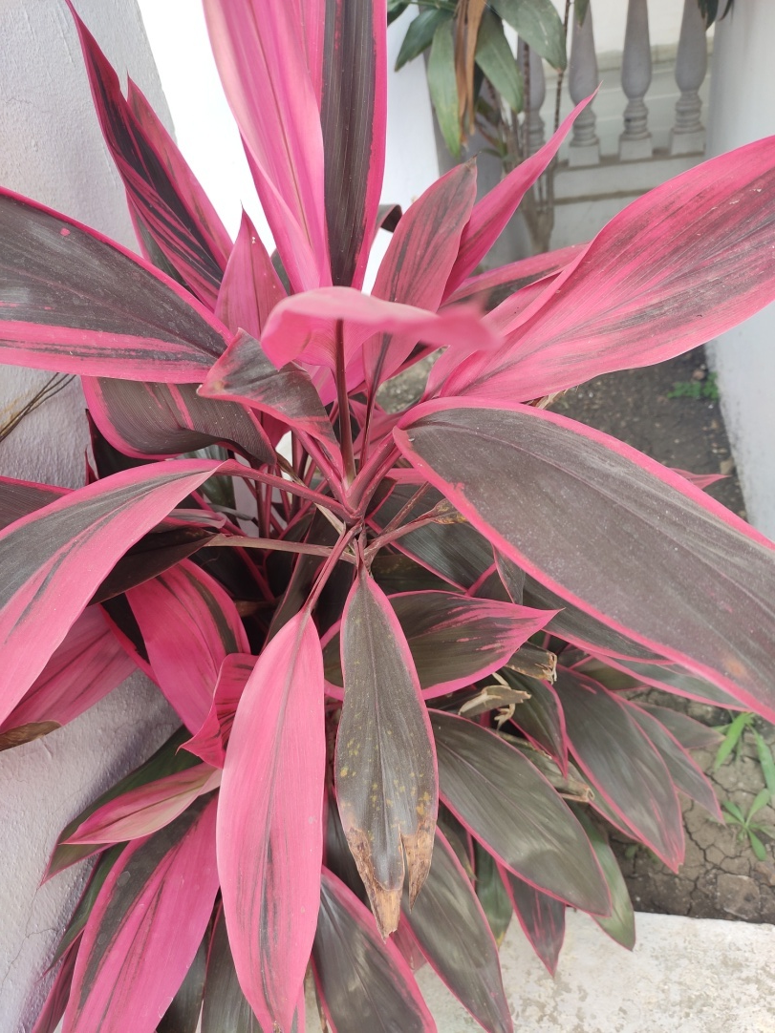
Dracaena Mahatma

Slide 6
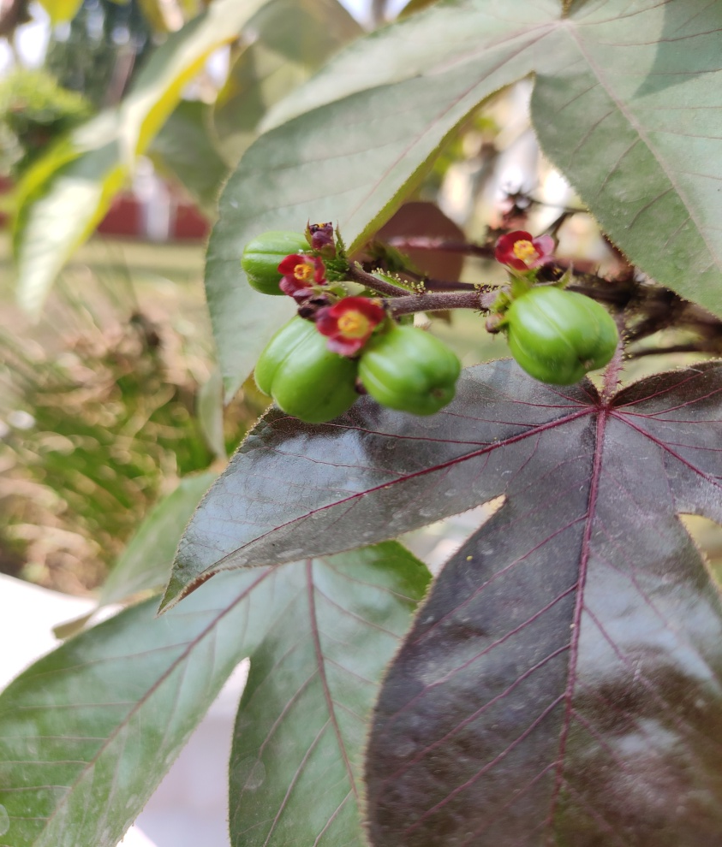
Jatropha gossypiifolia
Kingdom:Plantae
Clade:Tracheophytes
Clade:Angiosperms
Clade:Eudicots
Clade:Rosids
Order:Malpighiales
Family:Euphorbiaceae
Genus:Jatropha
Species:J. gossypiifolia

Slide 7
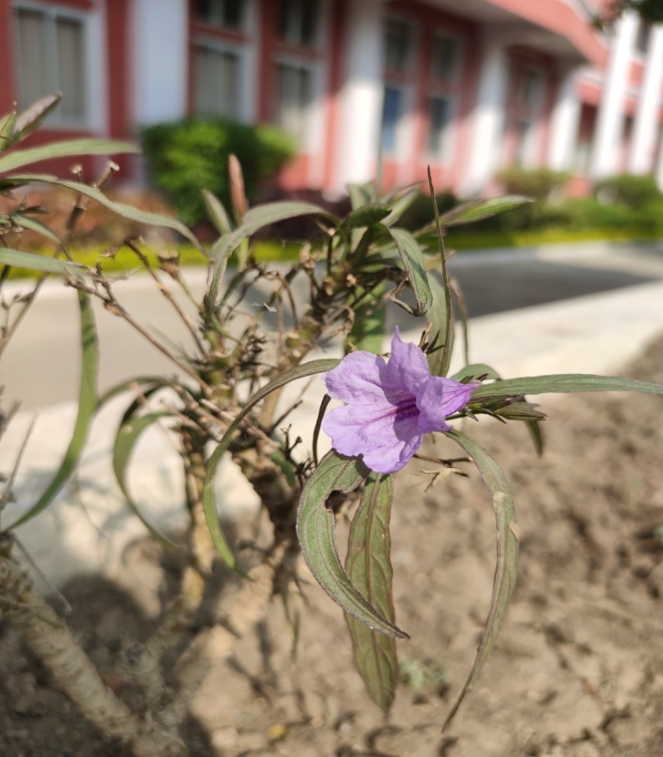
Ruellia Tuberosa
Kingdom:Plantae
Clade:Tracheophytes
Clade:Angiosperms
Clade:Eudicots
Clade:Asterids
Order:Lamiales
Family:Acanthaceae
Genus:Ruellia
Species:R. tuberosa

Slide 8
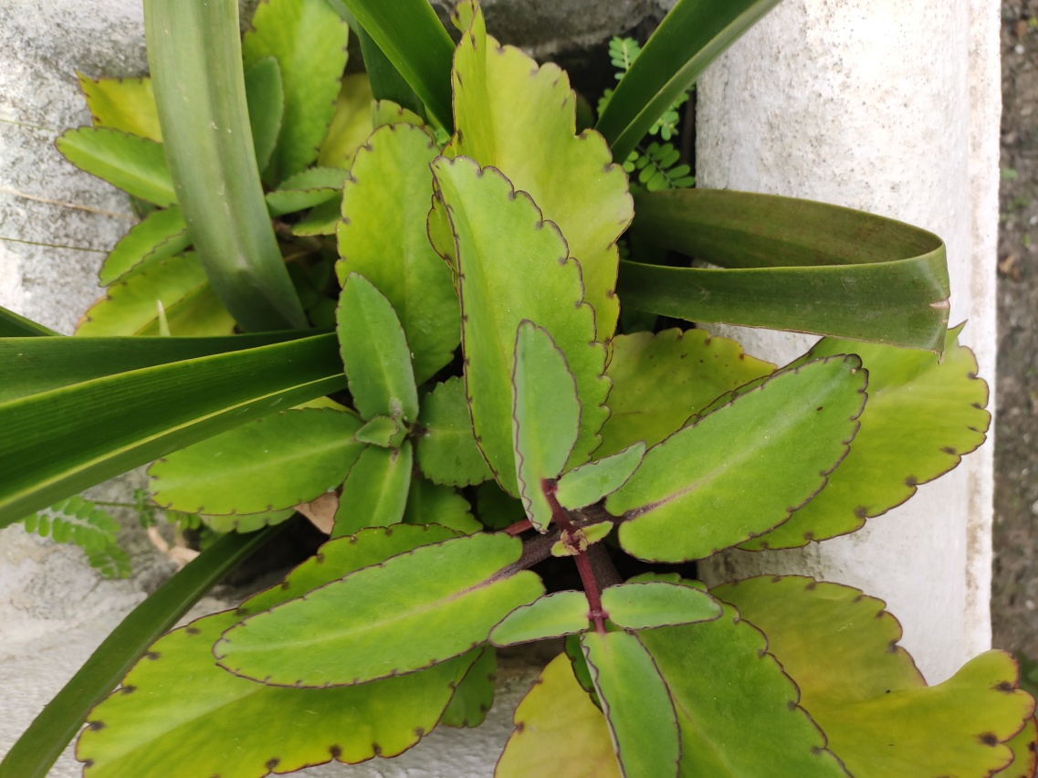
bryophyllum pinnatum
Kingdom:Plantae
(unranked):Angiosperms
(unranked):Eudicots
(unranked):Core eudicots
Order:Saxifragales
Family:Crassulaceae
Genus:Bryophyllum
Species:B. pinnatum

Slide 9
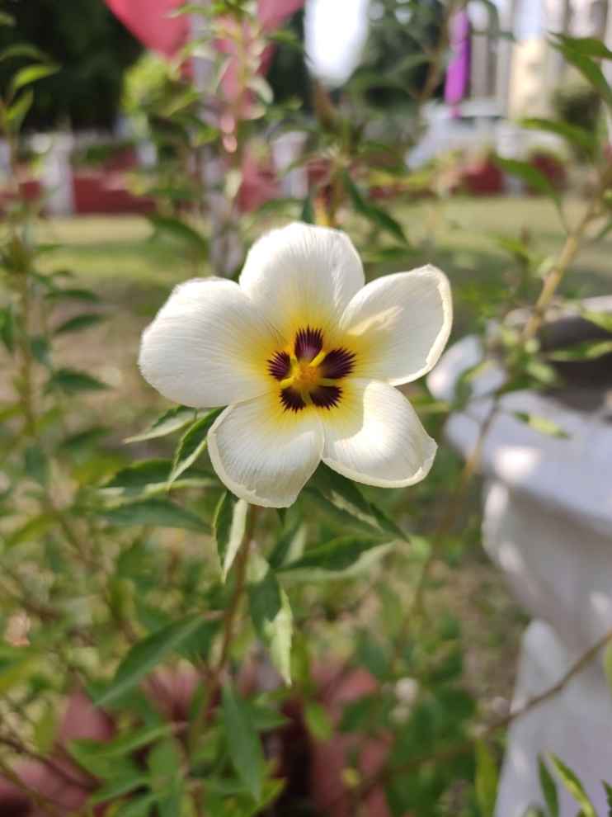
Turnera subulata
Kingdom:Plantae
Clade:Tracheophytes
Clade:Angiosperms
Clade:Eudicots
Clade:Rosids
Order:Malpighiales
Family:Passifloraceae
Genus:Turnera
Species:T. subulata

Slide 10
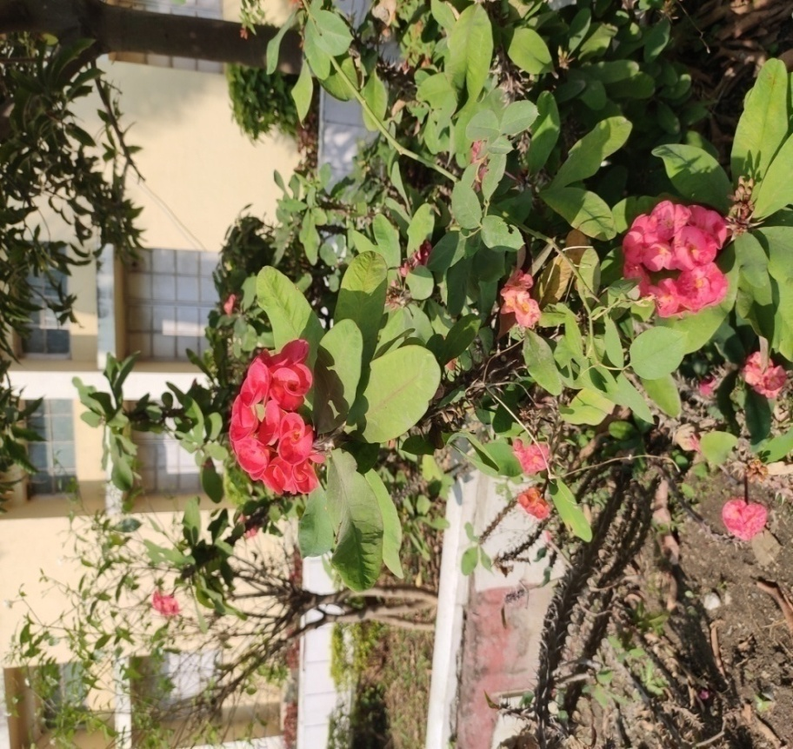
euphorbia milii
Kingdom:Plantae
Clade:Tracheophytes
Clade:Angiosperms
Clade:Eudicots
Clade:Rosids
Order:Malpighiales
Family:Euphorbiaceae
Genus:Euphorbia
Species:E. milii

Slide 11
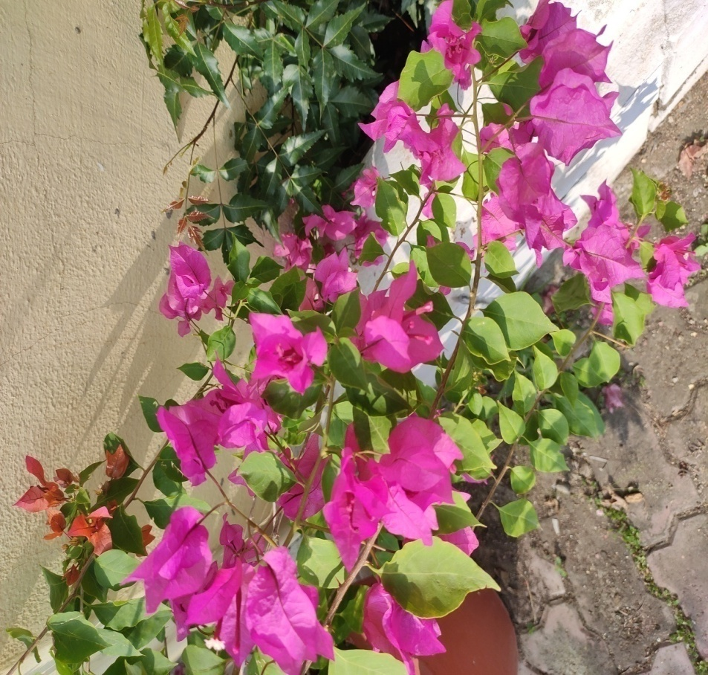
bougainvillea glabra
Kingdom:Plantae
Clade:Tracheophytes
Clade:Angiosperms
Clade:Eudicots
Order:Caryophyllales
Family:Nyctaginaceae
Genus:Bougainvillea
Species:B. glabra

Slide 12
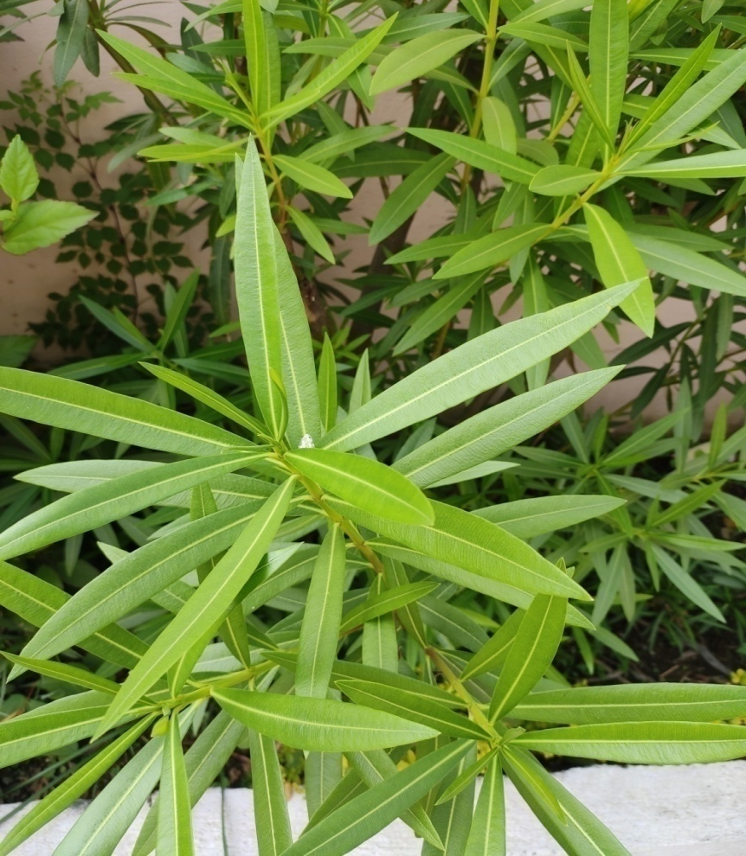
oleander
Kingdom:Plantae
Clade:Tracheophytes
Clade:Angiosperms
Clade:Eudicots
Clade:Asterids
Order:Gentianales
Family:Apocynaceae
Subfamily:Apocynoideae
Tribe:Wrightieae
Genus:Nerium
Species:N. oleander

Slide 13
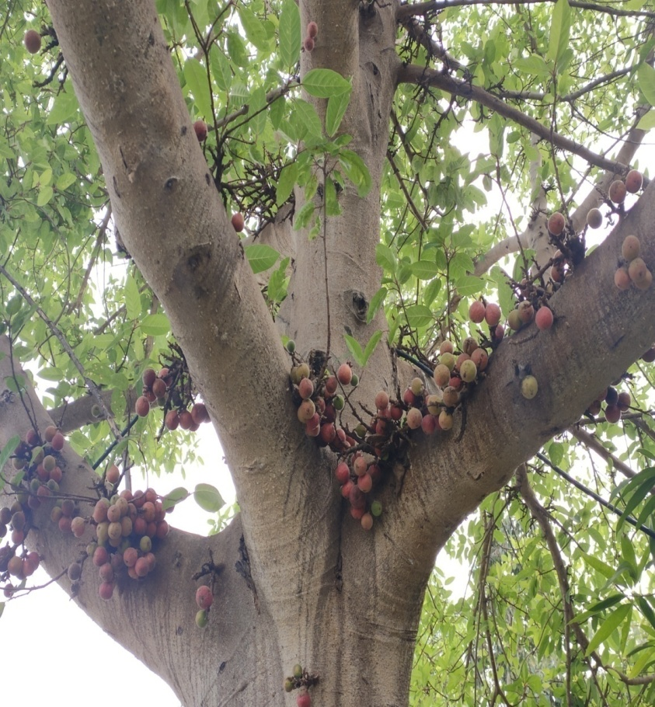
Ficus sycomorus
Kingdom:Plantae
Clade:Tracheophytes
Clade:Angiosperms
Clade:Eudicots
Clade:Rosids
Order:Rosales
Family:Moraceae
Genus:Ficus
Species:F. sycomorus
Notes:
Torbay Dazzler

Slide 14
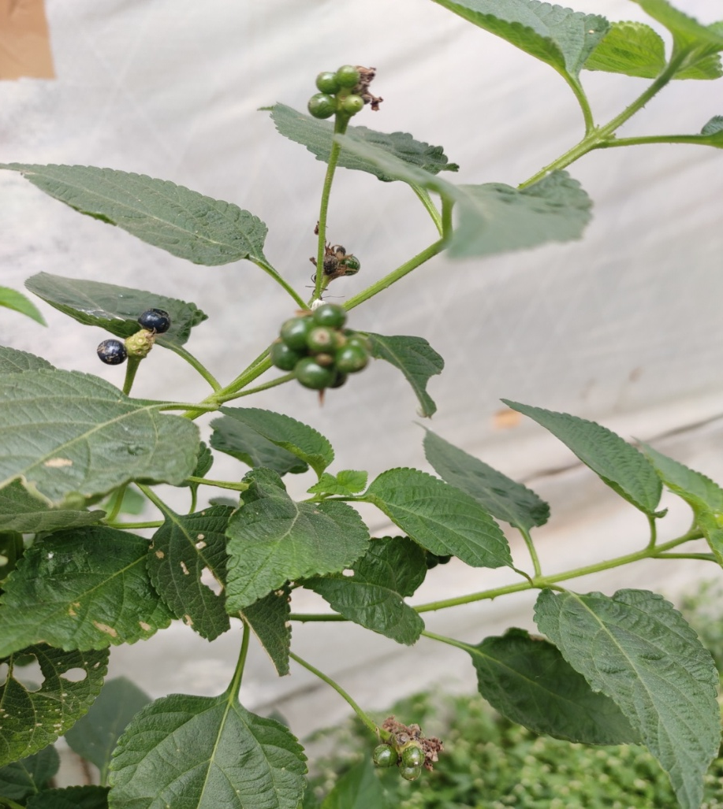
lantana camara
Kingdom:Plantae
Clade:Tracheophytes
Clade:Angiosperms
Clade:Eudicots
Clade:Asterids
Order:Lamiales
Family:Verbenaceae
Genus:Lantana
Species:L. camara

Slide 15
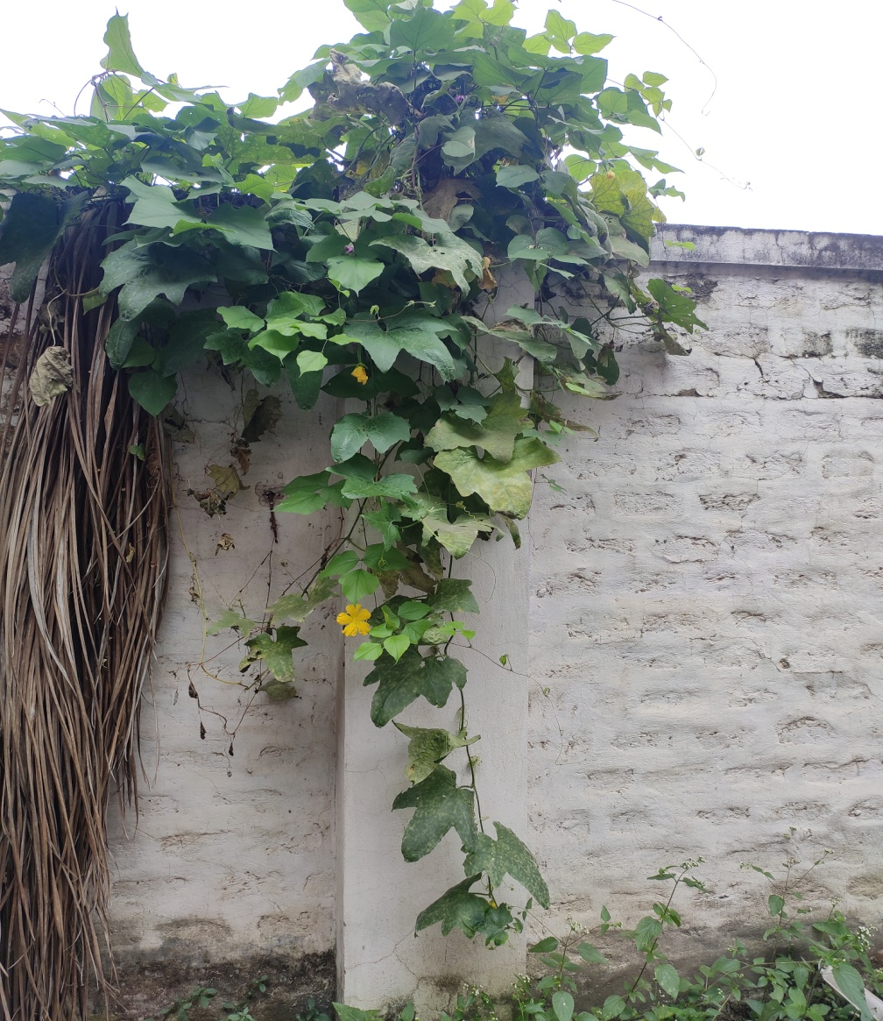
sponge gourd
Kingdom:Plantae
Clade:Tracheophytes
Clade:Angiosperms
Clade:Eudicots
Clade:Rosids
Order:Cucurbitales
Family:Cucurbitaceae
Genus:Luffa
Species:L. cylindrica

Slide 16
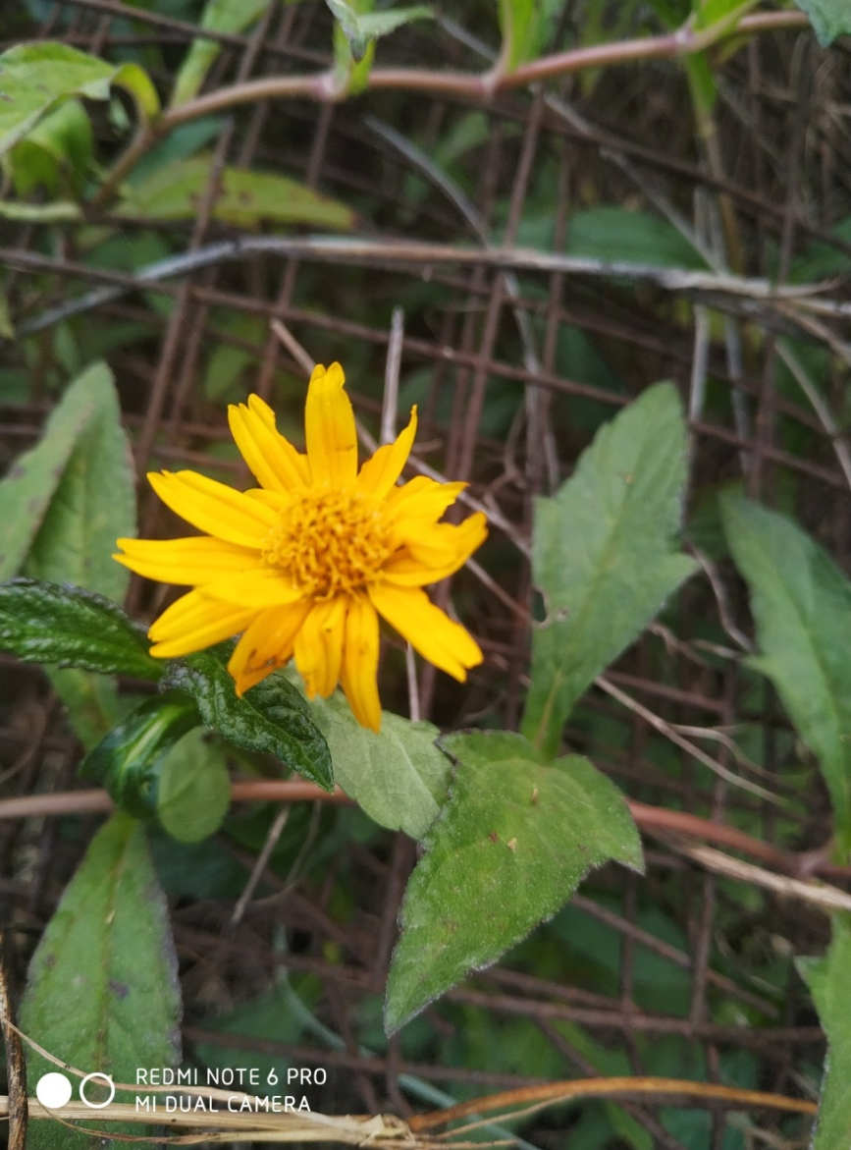
sphagneticola trilobata
Kingdom:Plantae
(unranked):Angiosperms
(unranked):Eudicots
(unranked):Asterids
Order:Asterales
Family:Asteraceae
Genus:Sphagneticola
Species:S. trilobata

Slide 17
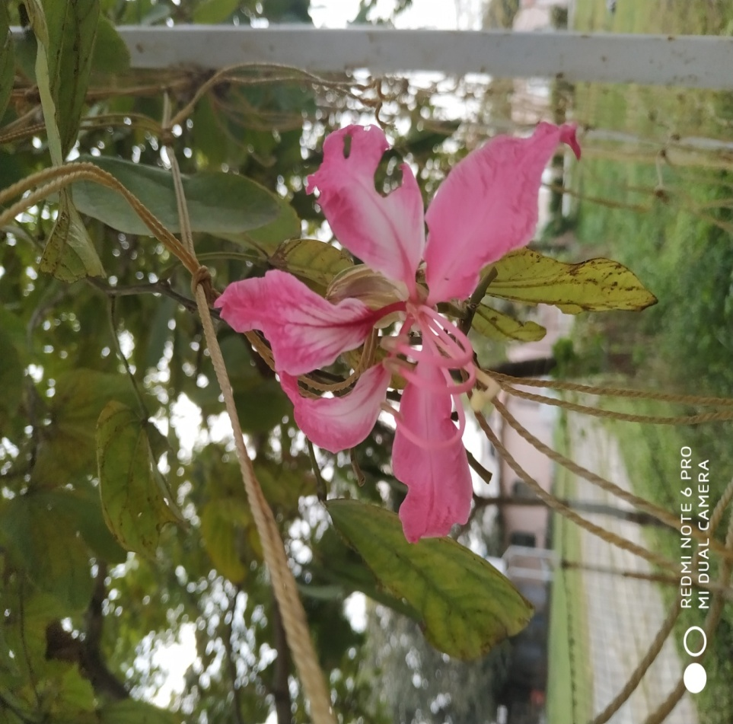
phanera purpurea
Kingdom:Plantae
Clade:Tracheophytes
Clade:Angiosperms
Clade:Eudicots
Clade:Rosids
Order:Fabales
Family:Fabaceae
Genus:Phanera
Species:P. purpurea

Slide 18
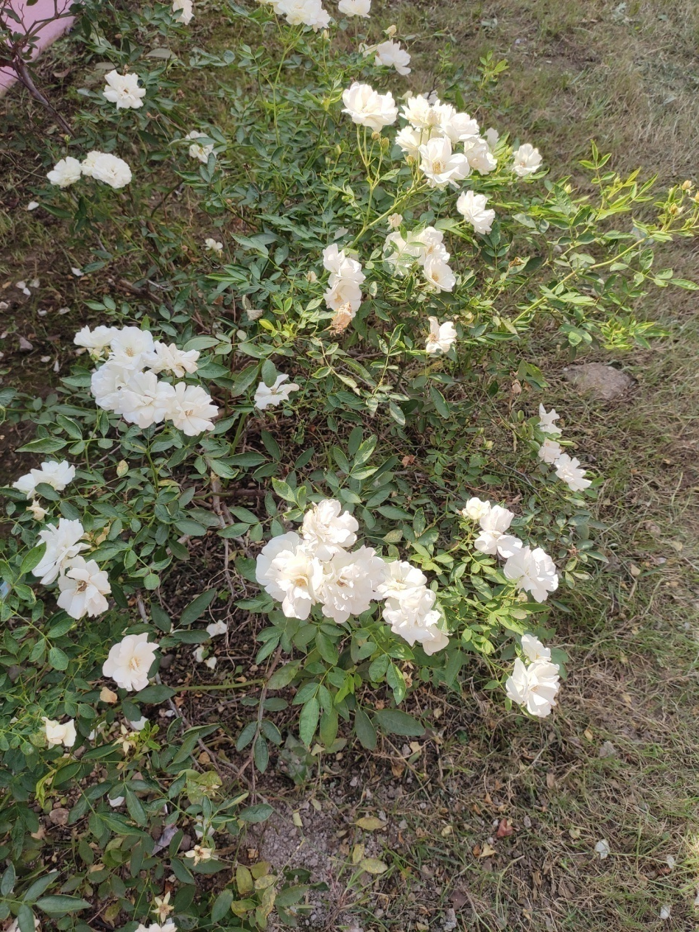
White rose of york
Kingdom:Plantae
Clade:Tracheophytes
Clade:Angiosperms
Clade:Eudicots
Clade:Rosids
Order:Rosales
Family:Rosaceae
Genus:Rosa
Species:R. × alba

Slide 19
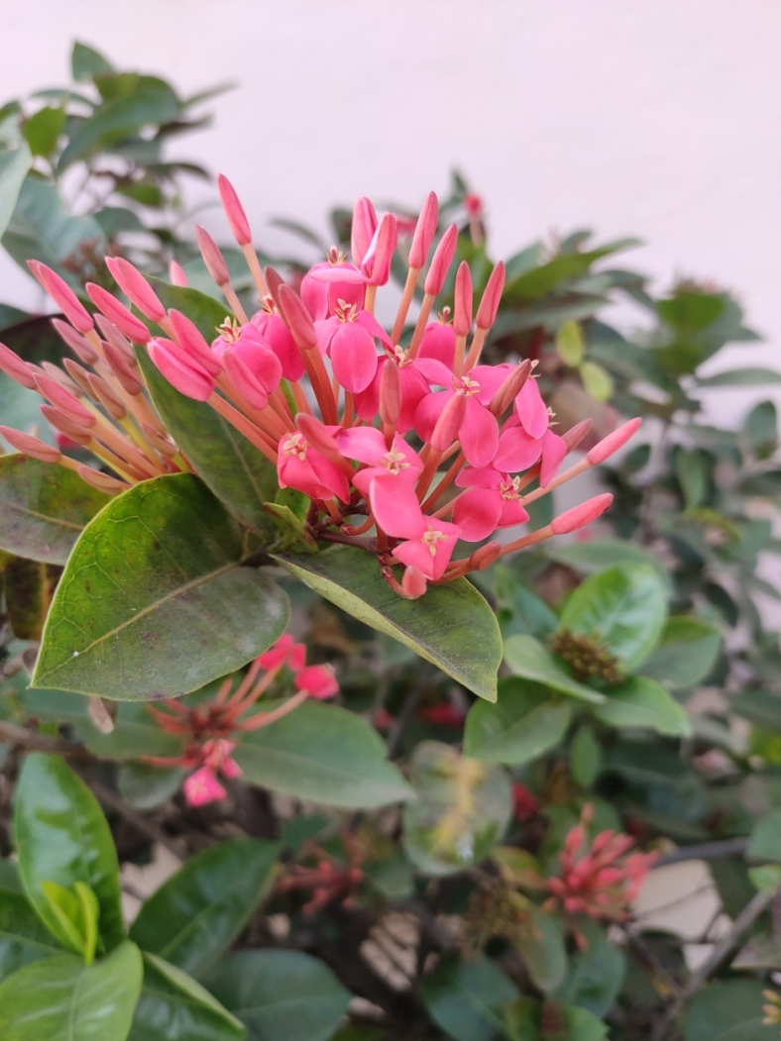
Ixora coccinea
Kingdom:Plantae
(unranked):Angiosperms
(unranked):Eudicots
(unranked):Asterids
Order:Gentianales
Family:Rubiaceae
Subfamily:Ixoroideae
Tribe:Ixoreae
Genus:Ixora
Species:I. coccinea

Slide 20
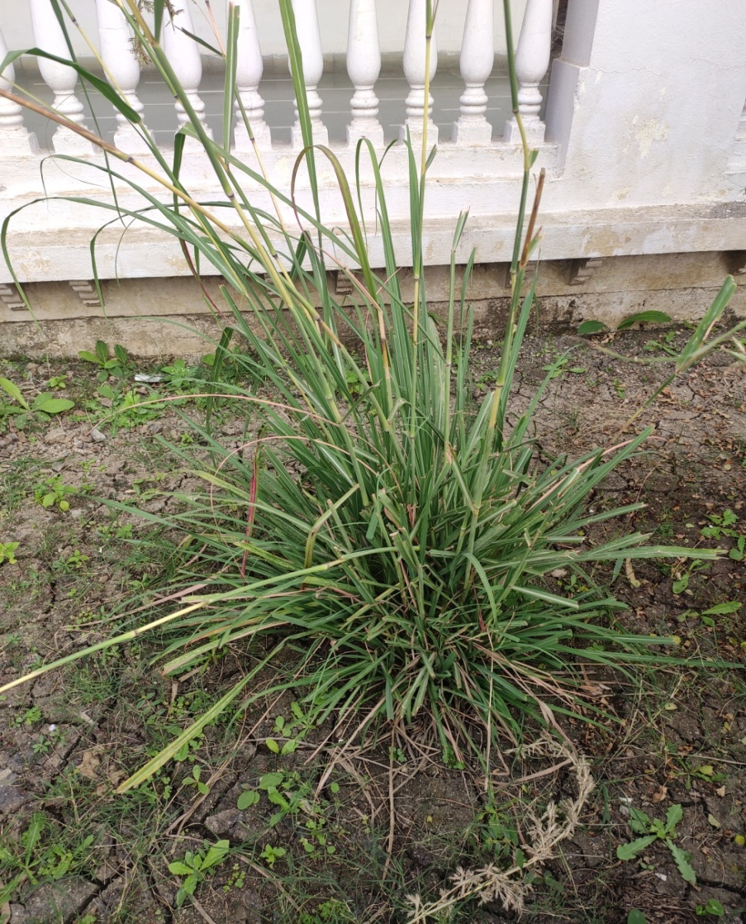
cymbopogon citratus
Kingdom:Plantae
Clade:Tracheophytes
Clade:Angiosperms
Clade:Monocots
Clade:Commelinids
Order:Poales
Family:Poaceae
Genus:Cymbopogon
Species:C. citratus

Slide 21
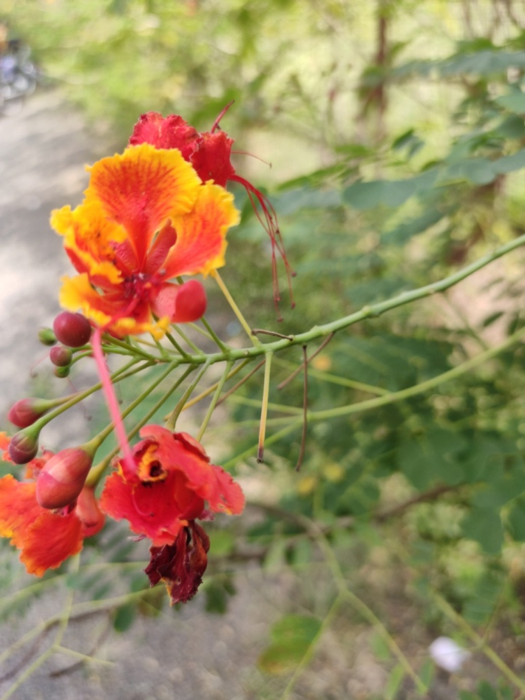
peacock flower
Kingdom:Plantae
(unranked):Angiosperms
(unranked):Eudicots
(unranked):Rosids
Order:Fabales
Family:Fabaceae
Genus:Caesalpinia
Species:C. pulcherrima

Slide 22
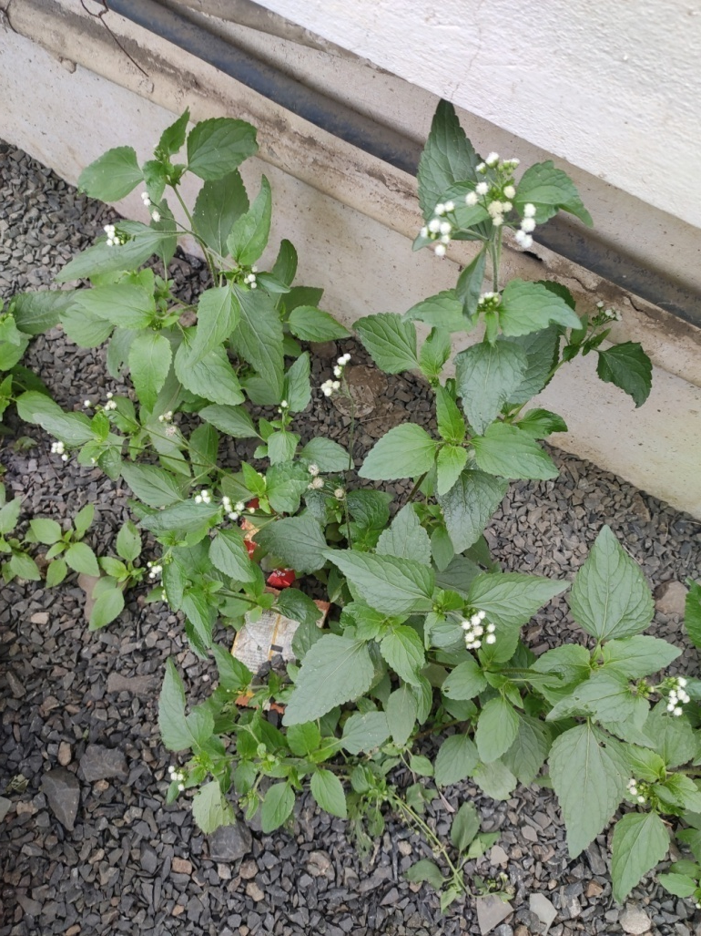
ageratum conyzoides
Kingdom:Plantae
(unranked):Angiosperms
(unranked):Eudicots
(unranked):Asterids
Order:Asterales
Family:Asteraceae
Tribe:Eupatorieae
Genus:Ageratum
Species:A. conyzoides

Slide 23
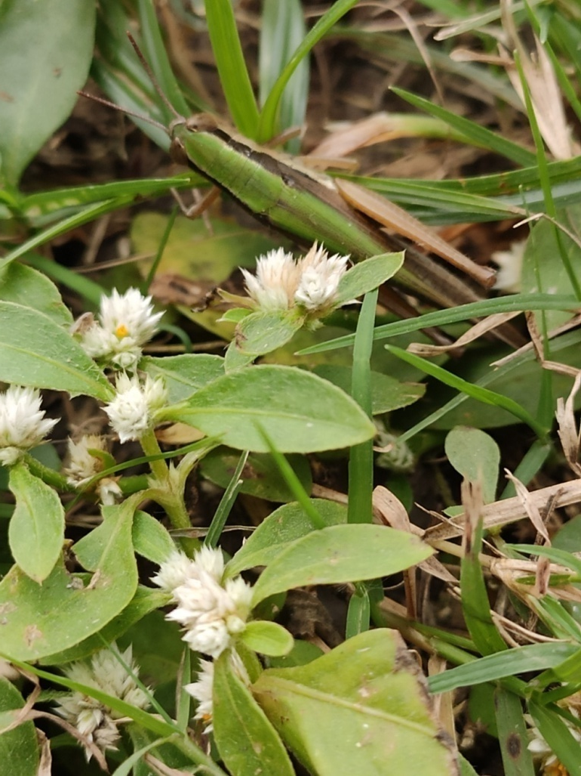
Alternanthera sessilis
Kingdom:Plantae
(unranked):Angiosperms
(unranked):Eudicots
(unranked):Core eudicots
Order:Caryophyllales
Family:Amaranthaceae
Subfamily:Gomphrenoideae
Genus:Alternanthera
Species:A. sessilis

Slide 24
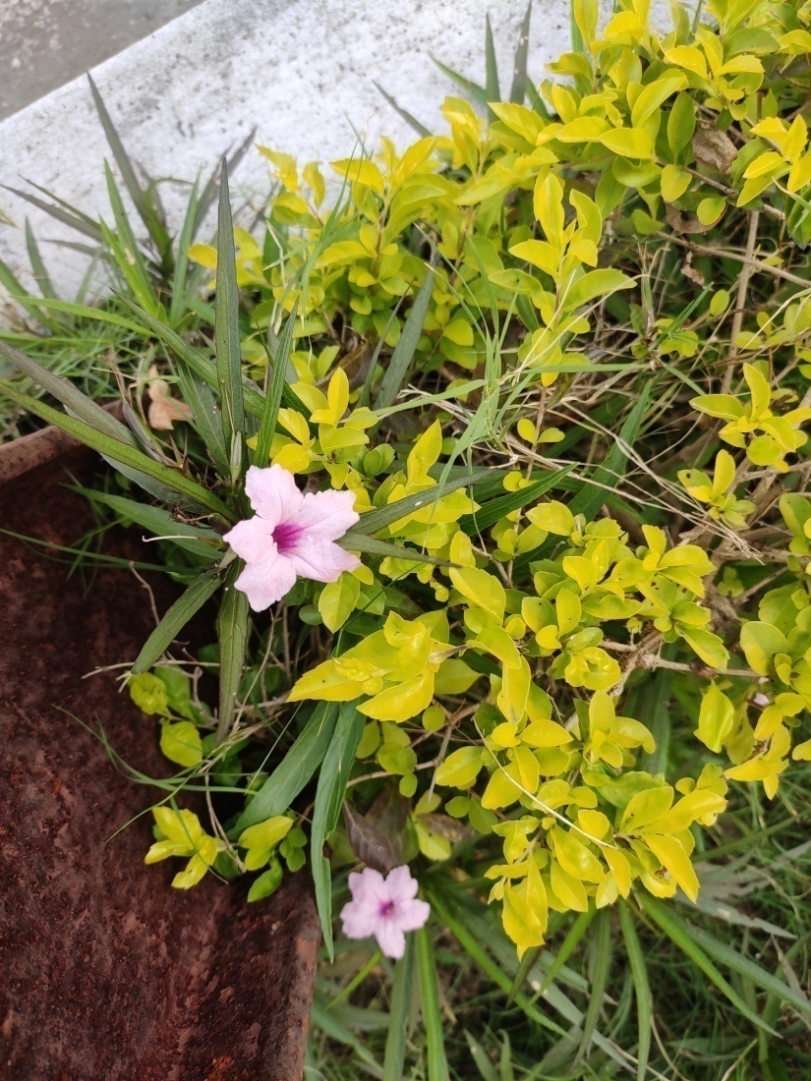
Ruellia simplex
Kingdom:Plantae
Clade:Tracheophytes
Clade:Angiosperms
Clade:Eudicots
Clade:Asterids
Order:Lamiales
Family:Acanthaceae
Genus:Ruellia
Species:R. simplex

Slide 25
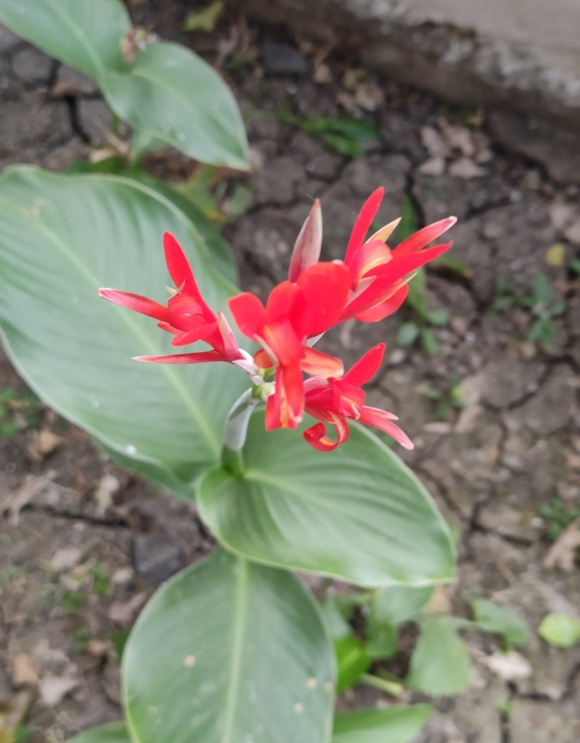
Canna indica
Kingdom:Plantae
Clade:Tracheophytes
Clade:Angiosperms
Clade:Monocots
Clade:Commelinids
Order:Zingiberales
Family:Cannaceae
Genus:Canna
Species:C. indica

Slide 26
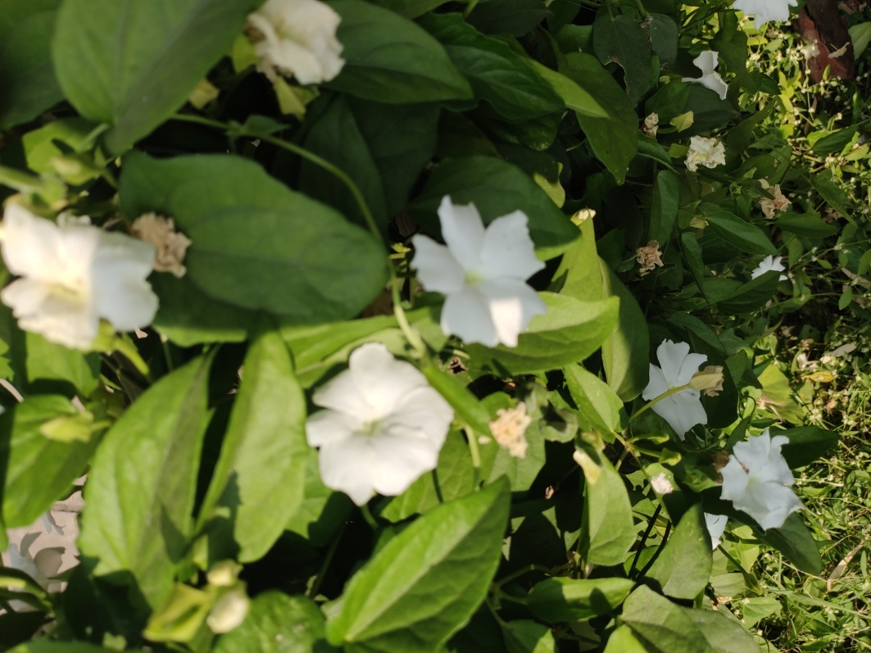
Thunbergia fragrans
Kingdom:Plantae
Clade:Tracheophytes
Clade:Angiosperms
Clade:Eudicots
Clade:Asterids
Order:Lamiales
Family:Acanthaceae
Genus:Thunbergia
Species:T. fragrans

Slide 27
Tecoma stans
Kingdom:Plantae
Clade:Tracheophytes
Clade:Angiosperms
Clade:Eudicots
Clade:Asterids
Order:Lamiales
Family:Bignoniaceae
Genus:Tecoma
Species:T. stans

Slide 28
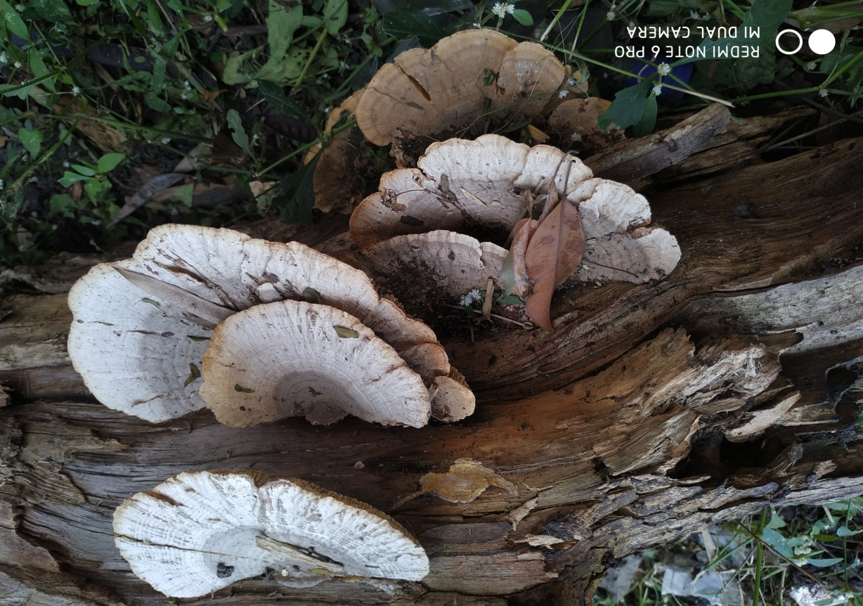
Trametes versicolor
Kingdom:Fungi
Division:Basidiomycota
Class:Agaricomycetes
Order:Polyporales
Family:Polyporaceae
Genus:Trametes
Species:T. versicolor

